Slide 1


HEP NTUA Weekly Report 7/7/2021
George Bakas

Slide 2
Summary
ttX analysis:
Still haven’t got all the files → 2016_preVFP just arrived
Signal Extraction → We have minor differences with Giannis but we want to make sure we have exactly the same output
Combination of all years in Fiducial level
Unfolding
Show systematic variations after unfolding for Parton and Particle levels
Combination of each variation in fiducial
Unfolding for each combined variation → combination of acceptance/efficiency and responses
Planning a ttX presentation for next week
Z’ analysis
Combination of datacards
Result on all channels (years)
Mass Cut Mapping :
{"mZ_1200_12":1000, "mZ_1400_14":1200, "mZ_1600_16":1400, "mZ_1800_18":1600, "mZ_2000_20":1600, "mZ_2500_25":2000, "mZ_3000_30":2000, "mZ_3500_35":2000, "mZ_4000_40":2000, "mZ_4500_45":2000}
Expectation Ratio (over 2018 result for example as reference) in order to check consistency of combined result

Slide 3
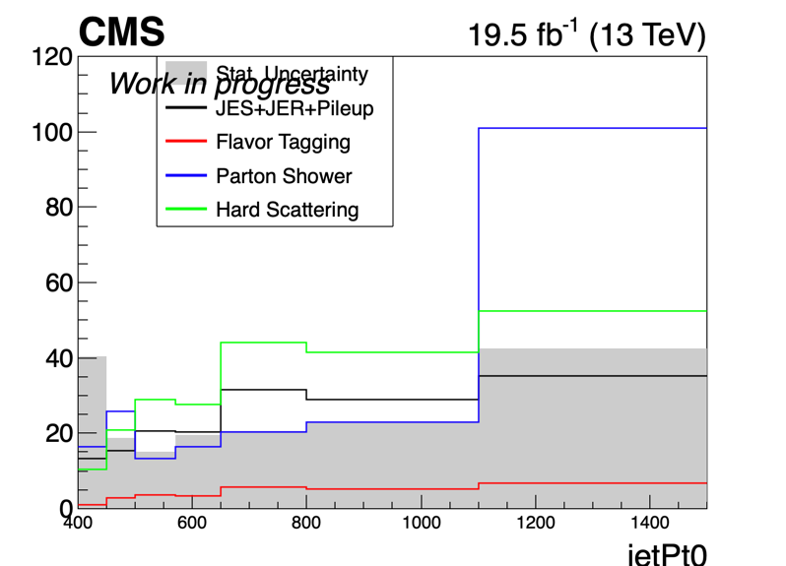
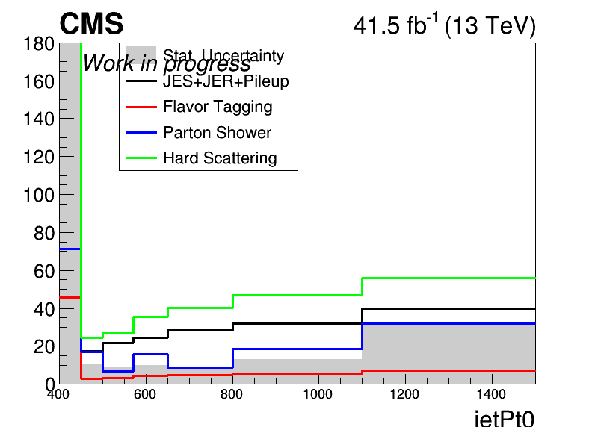
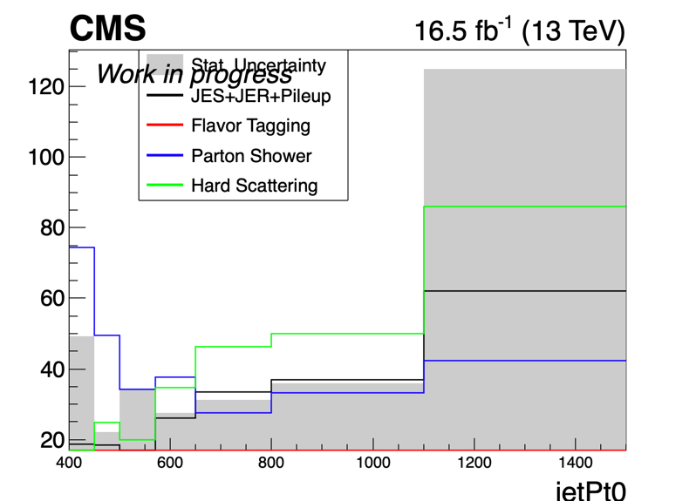
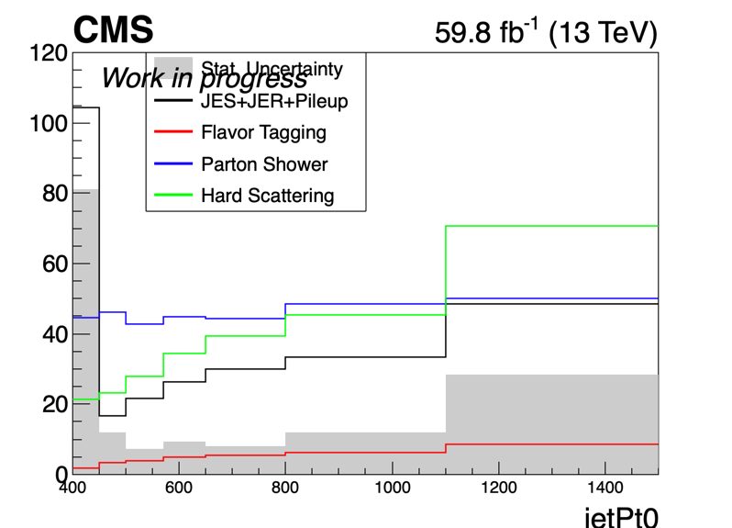
Errors in Particle Level (Work In Progress)
2016_preVFP
2017
2016_postVFP
2018

Slide 4
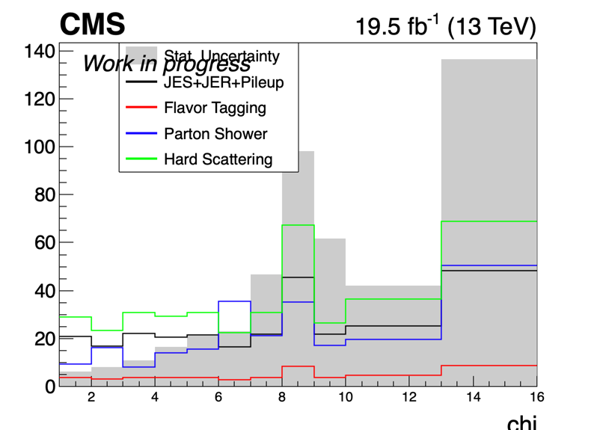
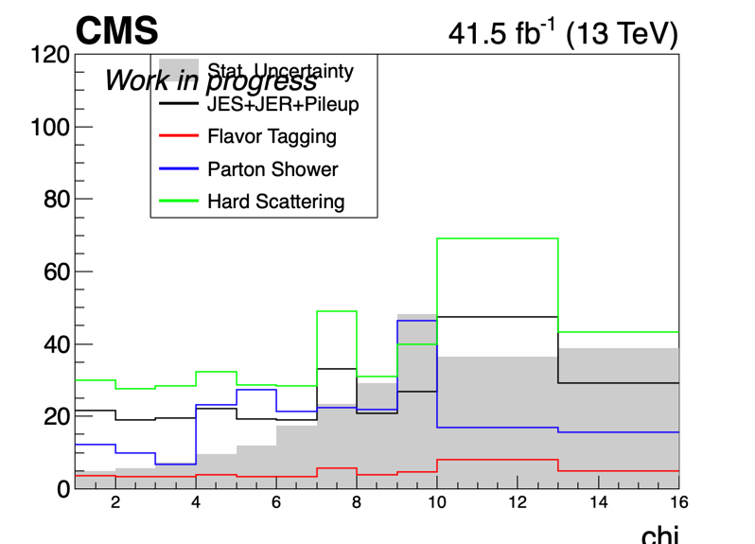
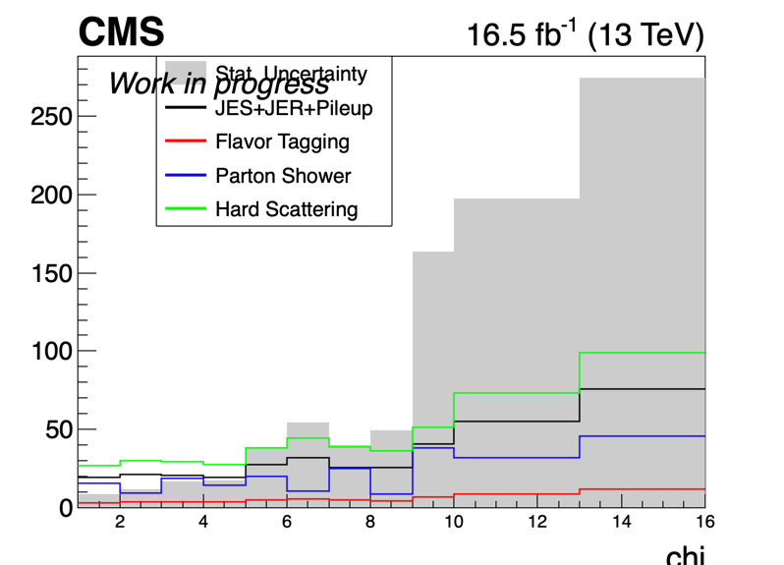
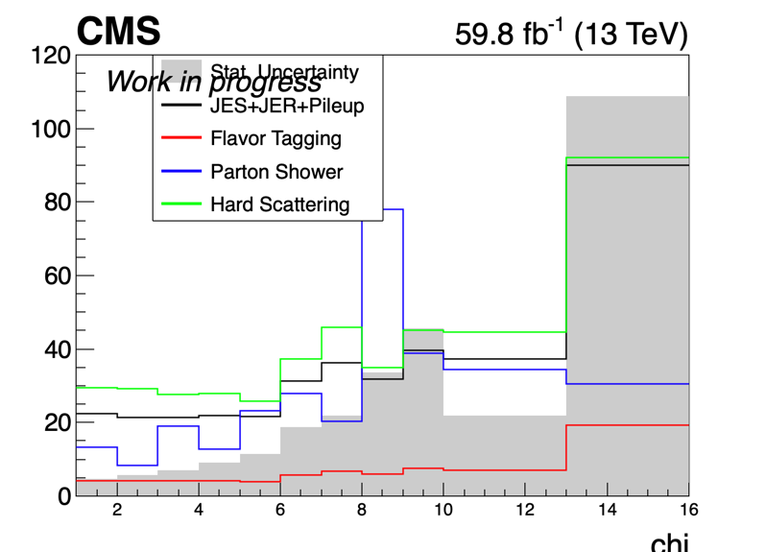
Errors in Particle Level(Work In Progress)
2016_preVFP
2017
2016_postVFP
2018

Slide 5
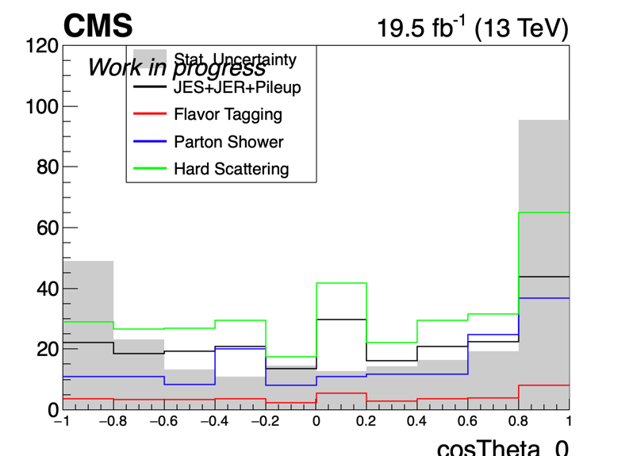
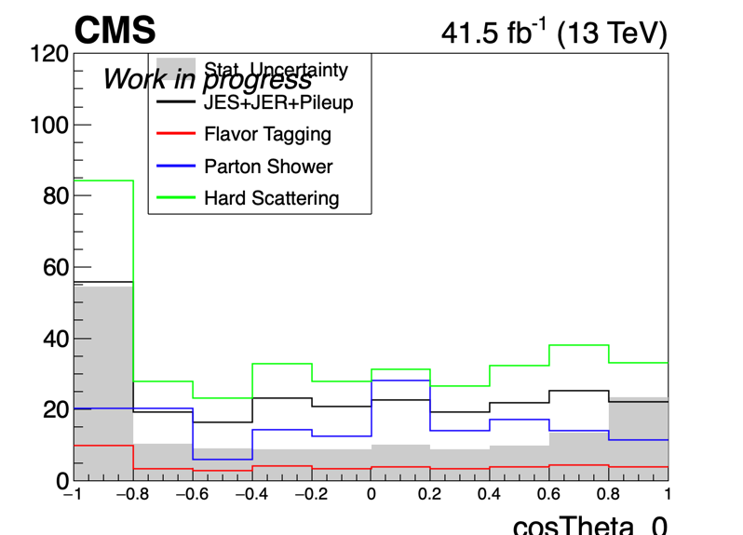
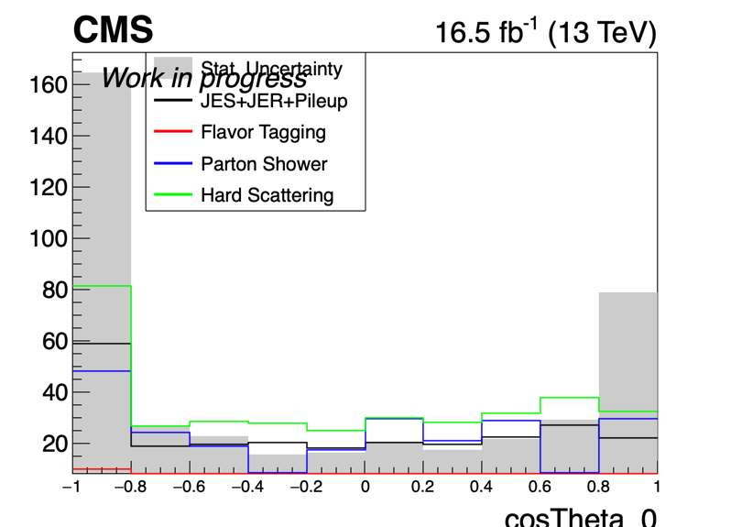
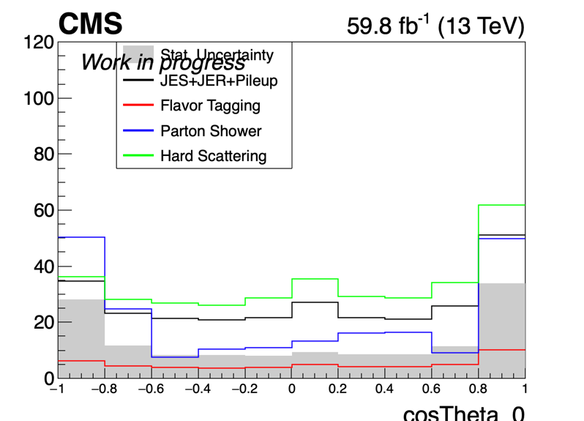
Errors in Particle Level (Work In Progress)
2016_preVFP
2017
2016_postVFP
2018

Slide 6
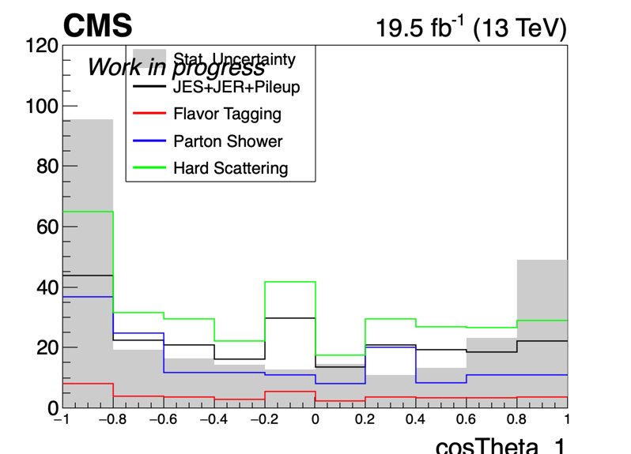
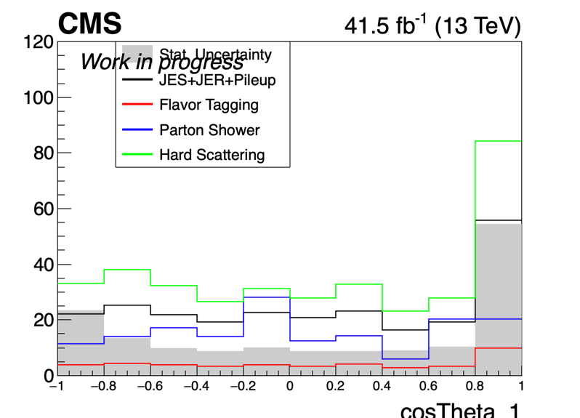
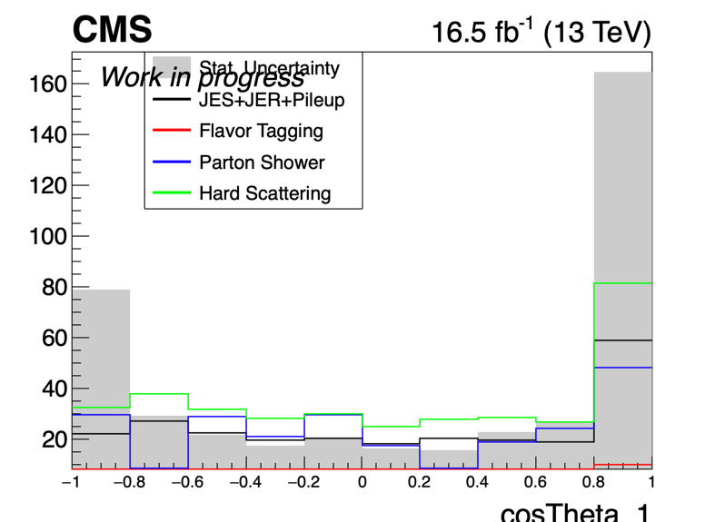
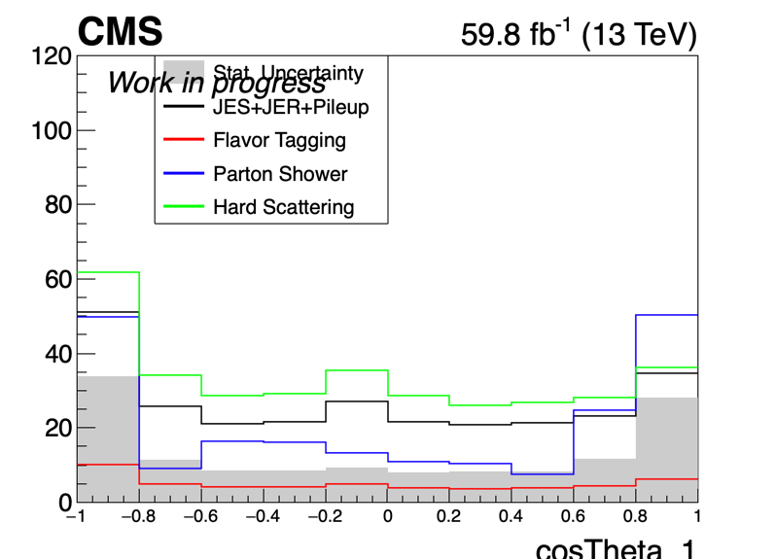
Errors in Particle Level (Work In Progress)
2016_preVFP
2017
2016_postVFP
2018

Slide 7
BACKUP

Slide 8
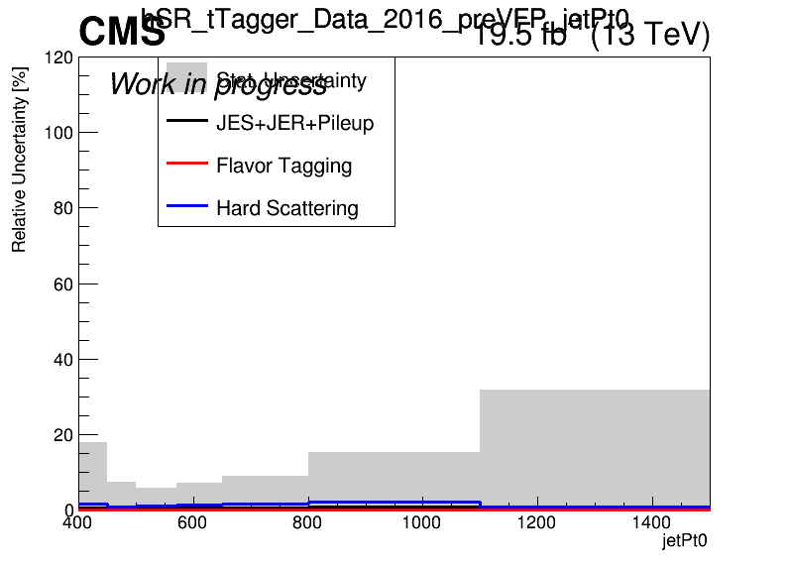
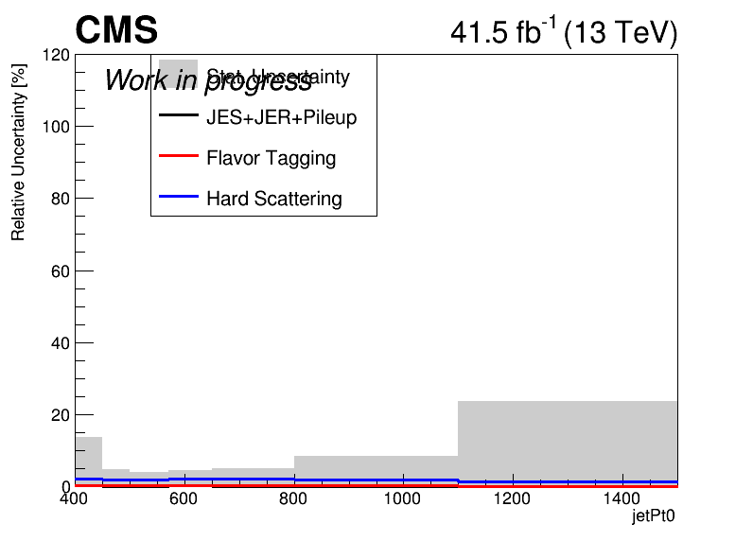
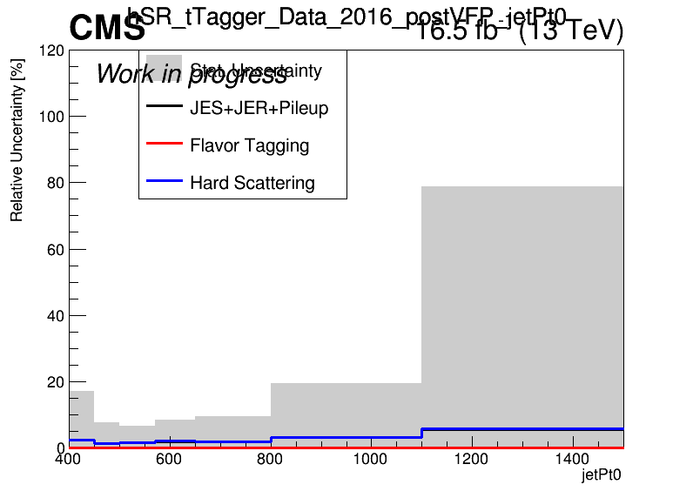
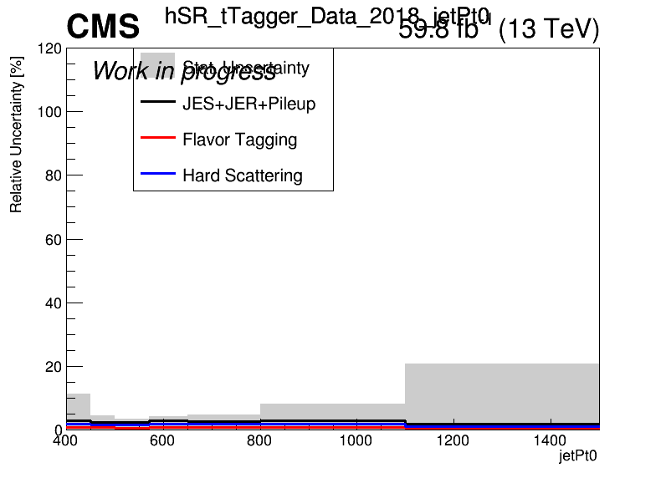
Errors in Fiducial Signal Extraction (Work In Progress)
2016_preVFP
2017
2016_postVFP
2018

Slide 9
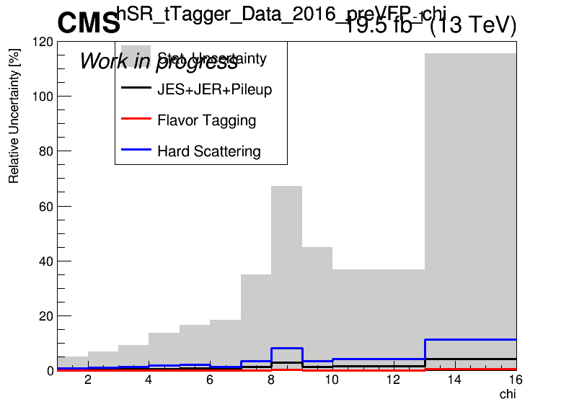
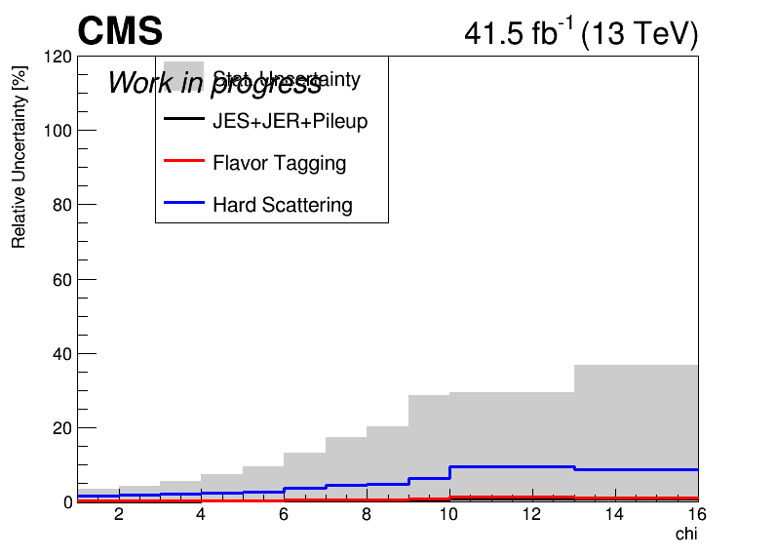
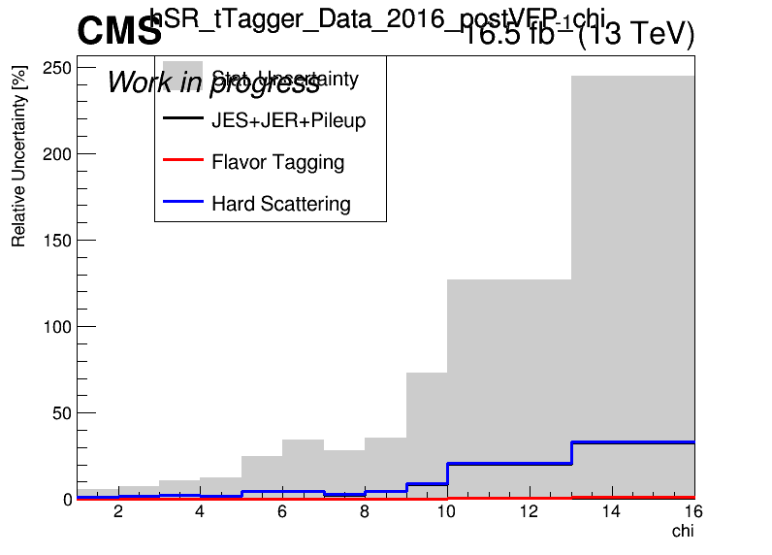
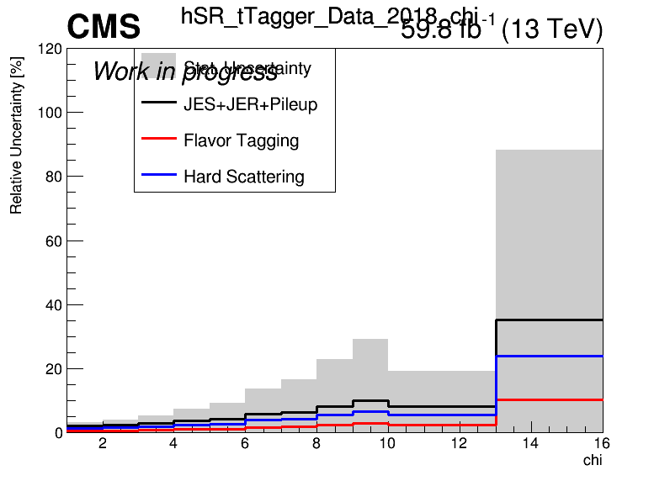
Errors in Fiducial Signal Extraction (Work In Progress)
2016_preVFP
2017
2016_postVFP
2018

Slide 10
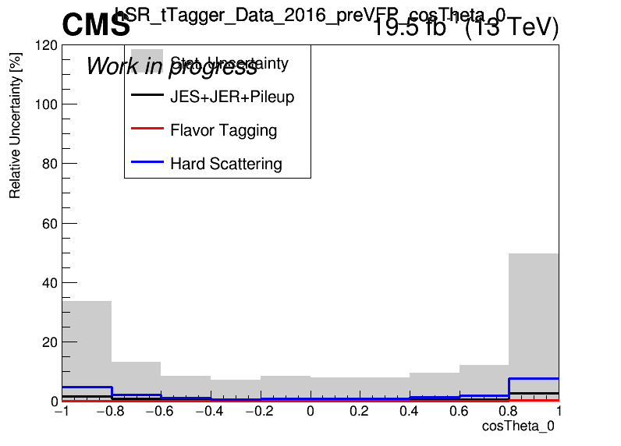
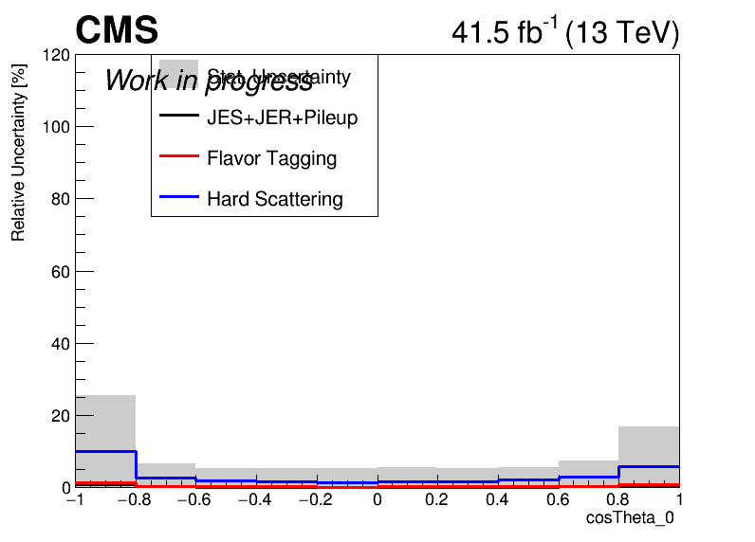
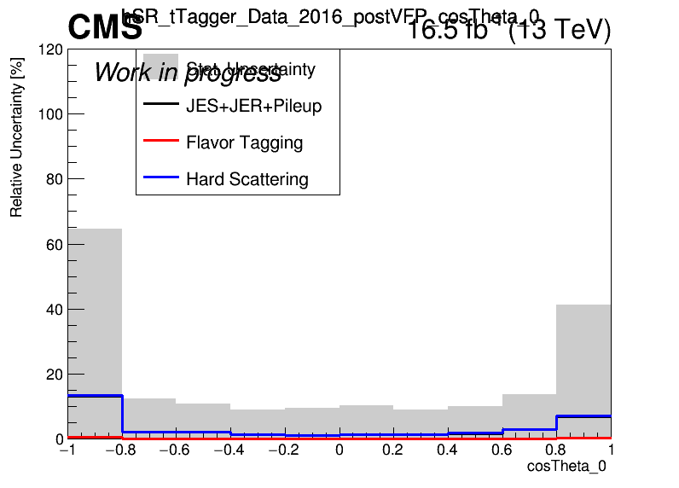
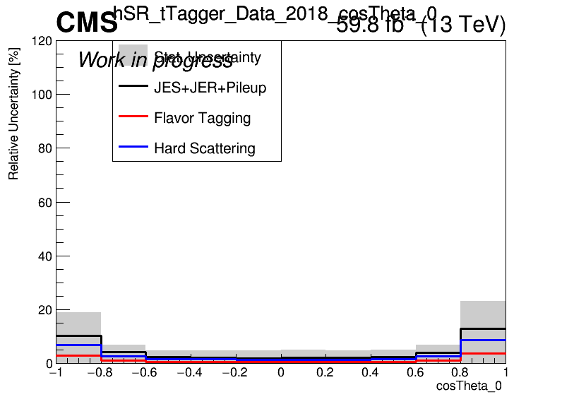
Errors in Fiducial Signal Extraction (Work In Progress)
2016_preVFP
2017
2016_postVFP
2018

Slide 11
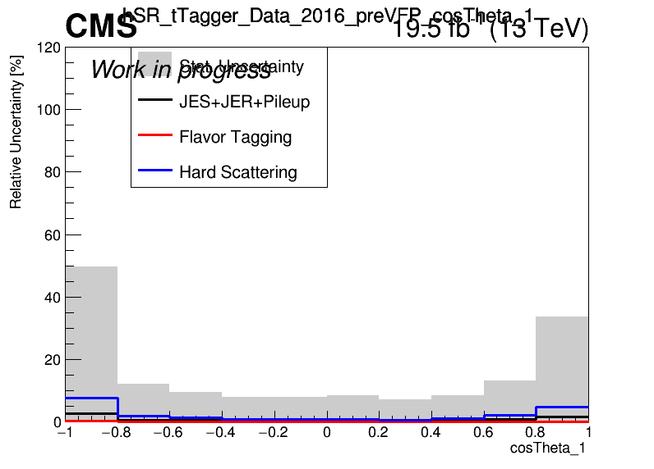
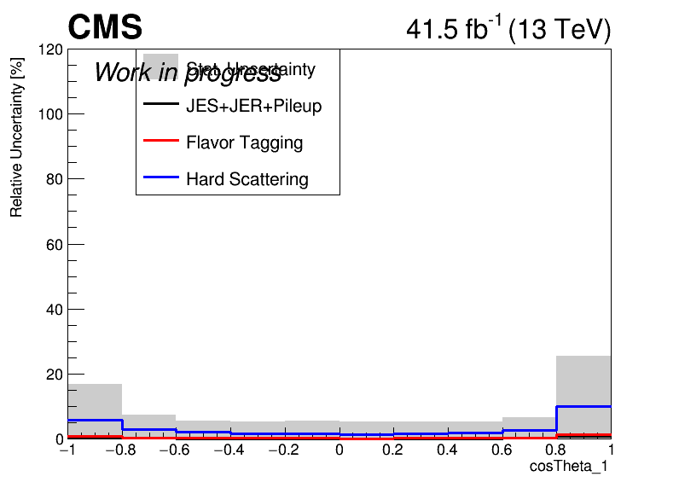
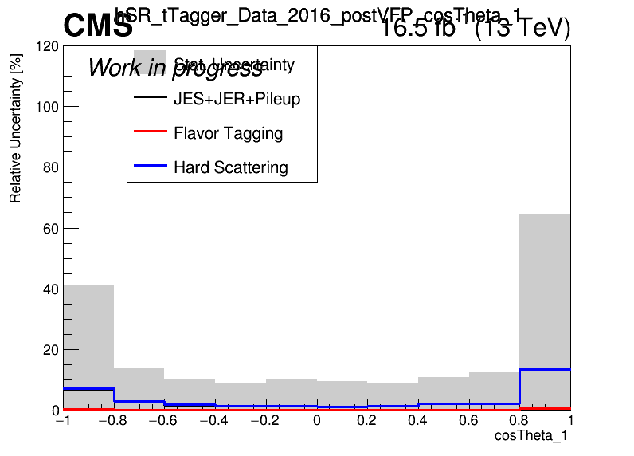
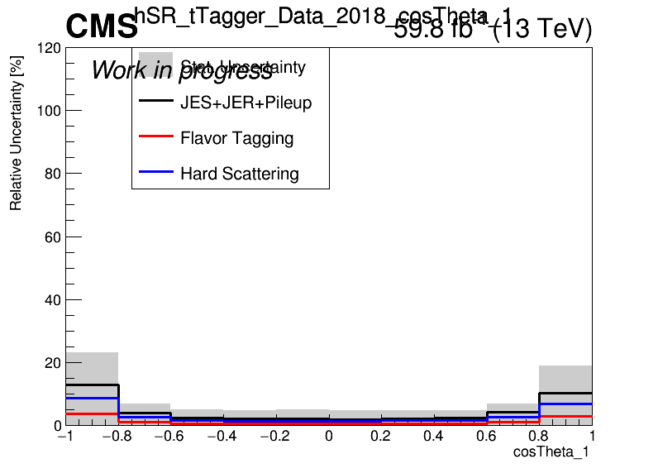
Errors in Fiducial Signal Extraction (Work In Progress)
2016_preVFP
2017
2016_postVFP
2018

Slide 12
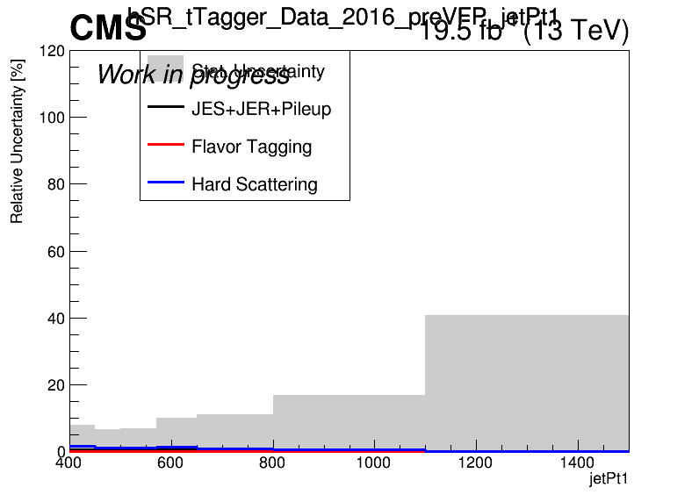
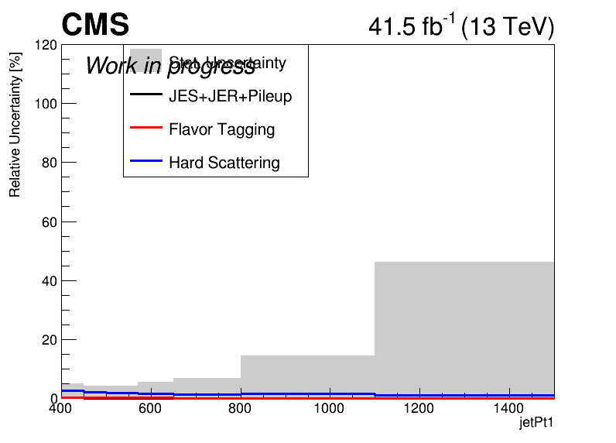
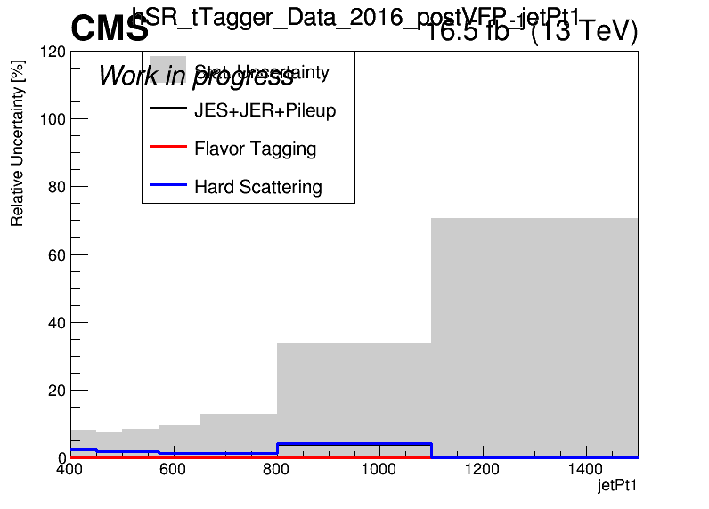
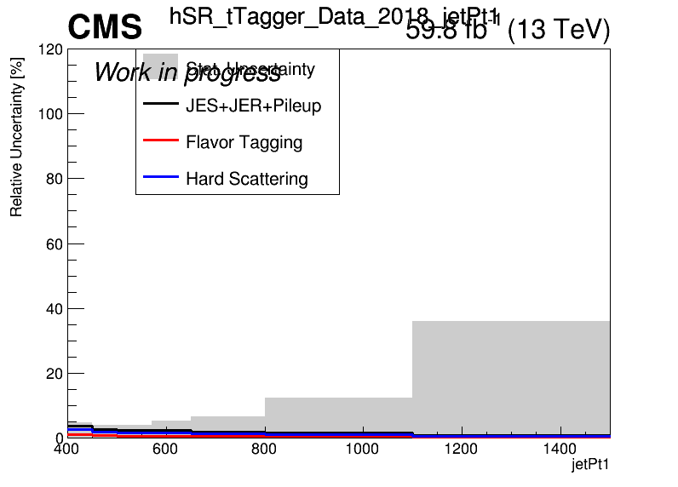
Errors in Fiducial Signal Extraction (Work In Progress)
2016_preVFP
2017
2016_postVFP
2018

Slide 13
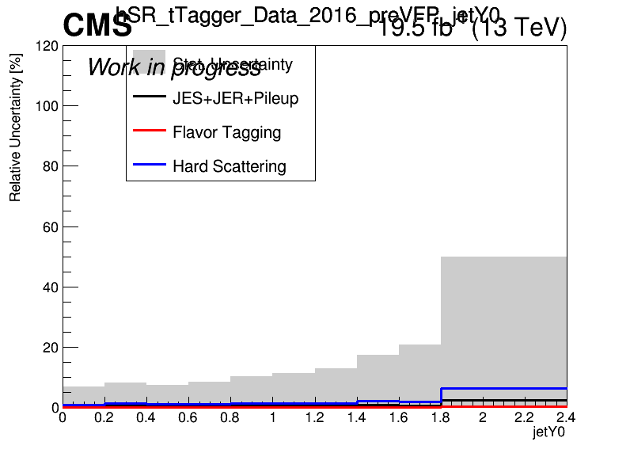
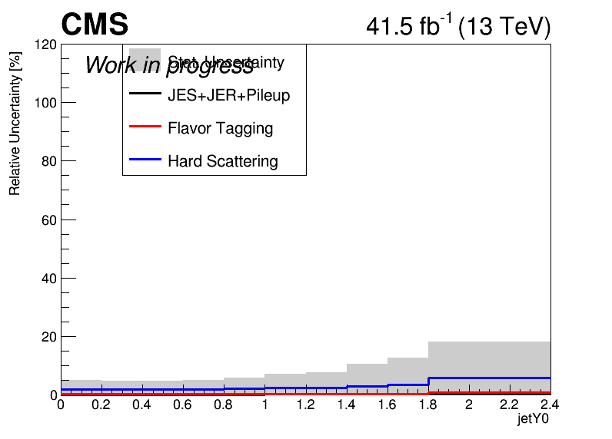
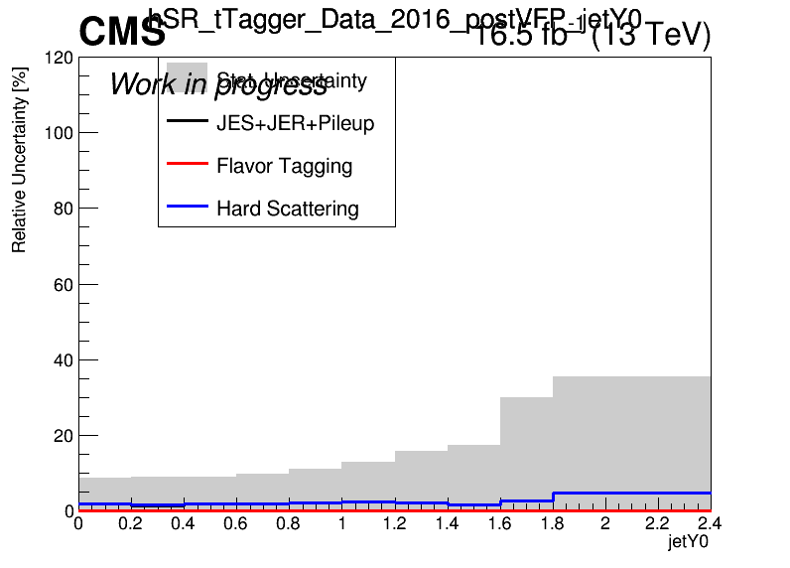
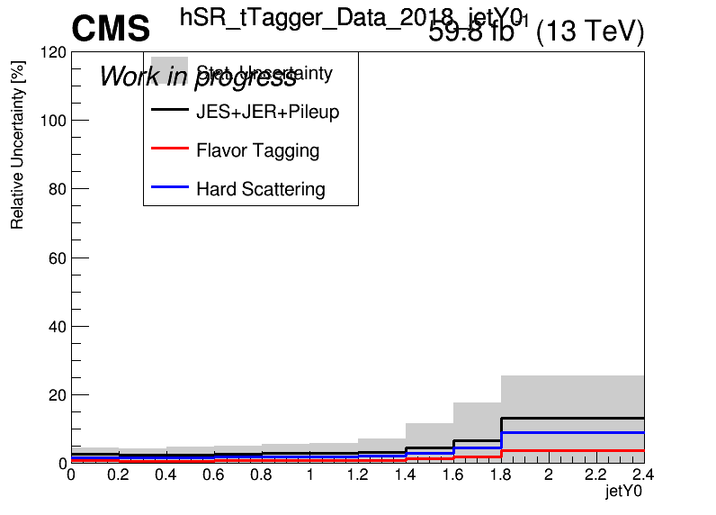
Errors in Fiducial Signal Extraction (Work In Progress)
2016_preVFP
2017
2016_postVFP
2018

Slide 14
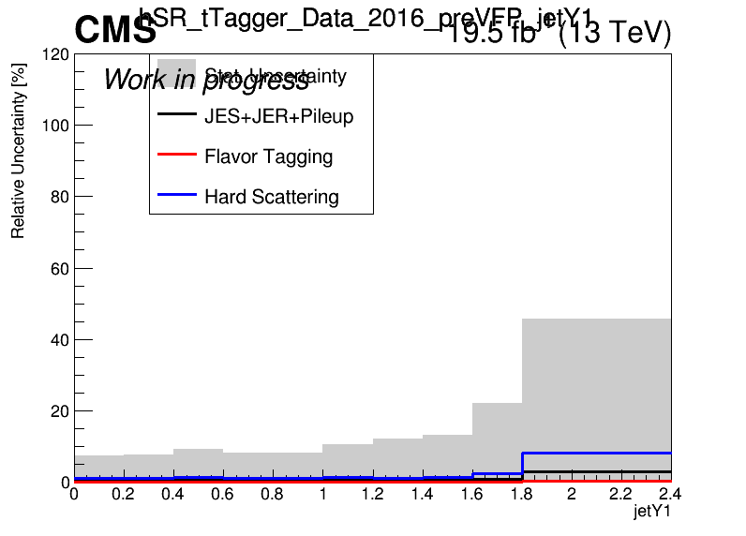
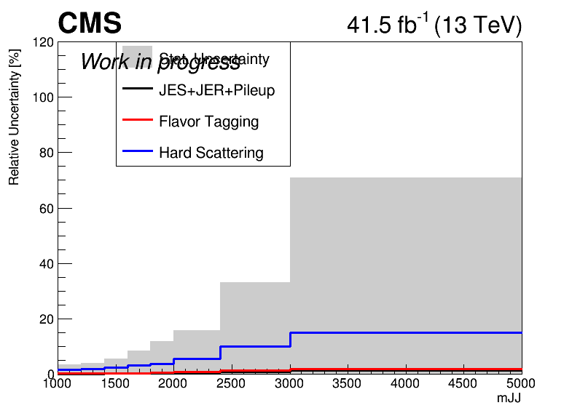
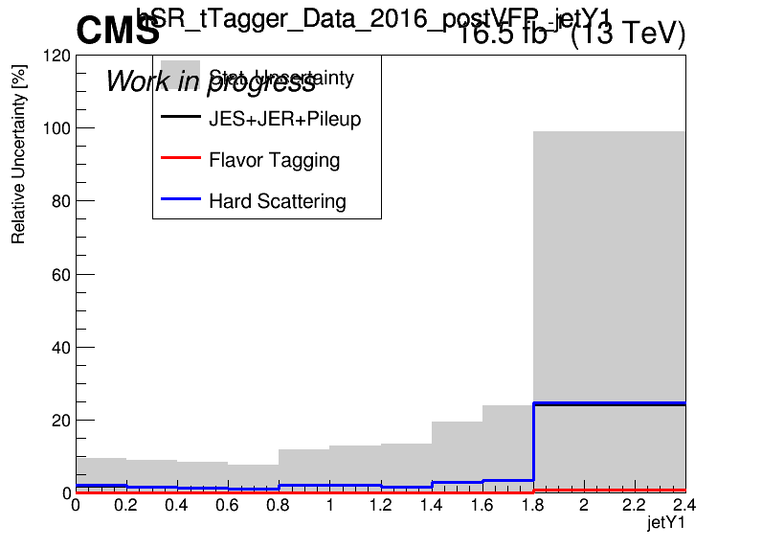
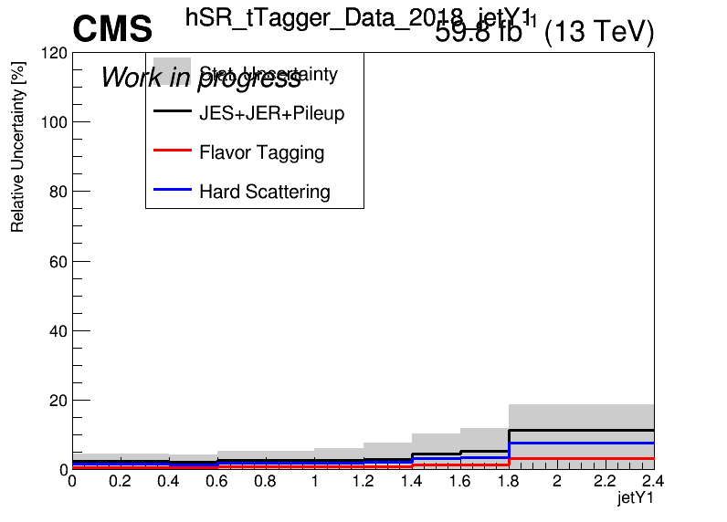
Errors in Fiducial Signal Extraction (Work In Progress)
2016_preVFP
2017
2016_postVFP
2018

Slide 15
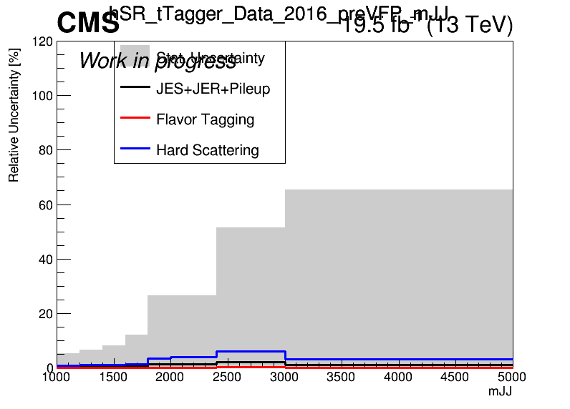
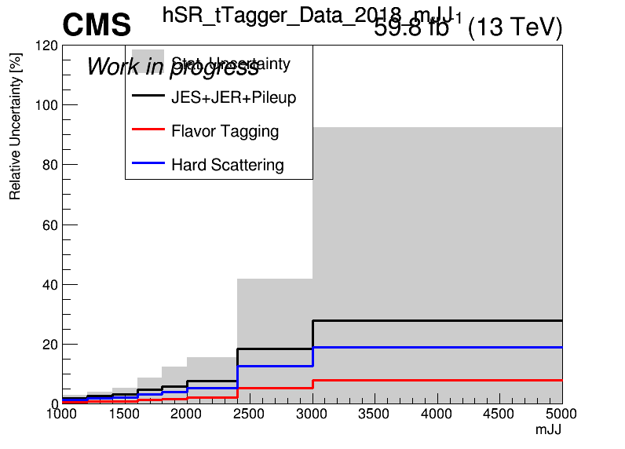
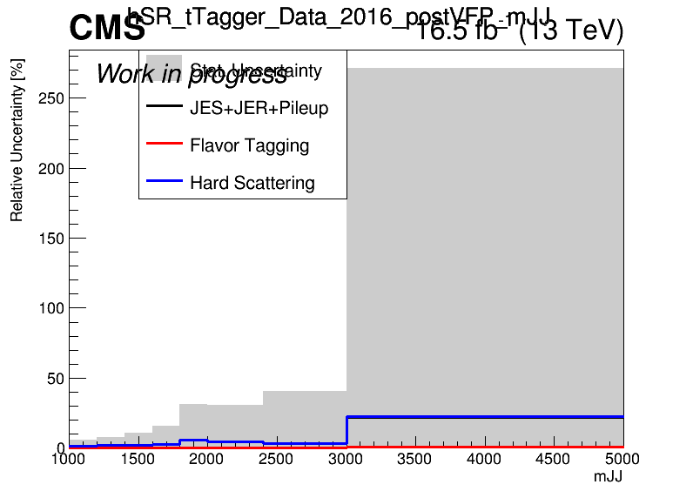
Errors in Fiducial Signal Extraction (Work In Progress)
2016_preVFP
2017
2016_postVFP
2018

Slide 16
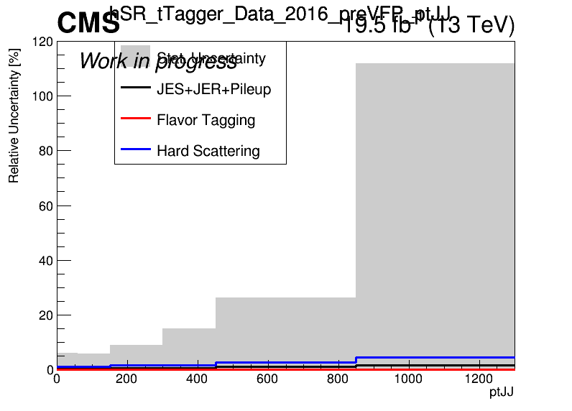
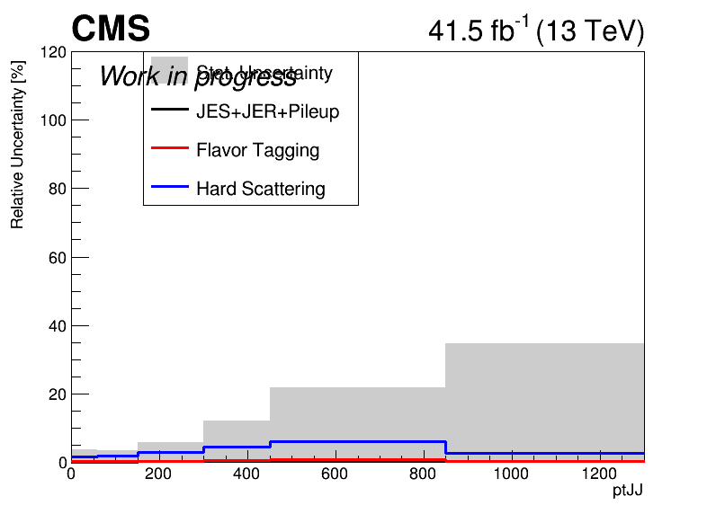
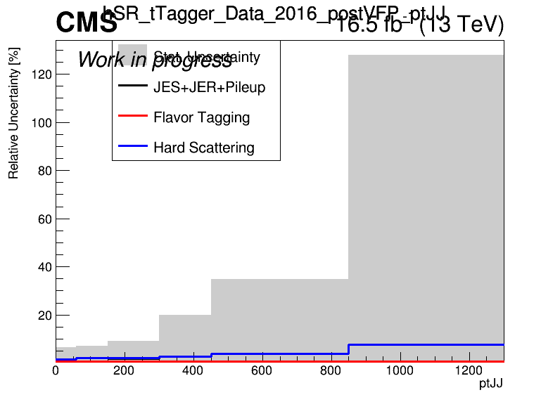

Errors in Fiducial Signal Extraction (Work In Progress)
2016_preVFP
2017
2016_postVFP
2018

Slide 17




Errors in Fiducial Signal Extraction (Work In Progress)
2016_preVFP
2017
2016_postVFP
2018

Slide 18



Brazilian Plots (2016_preVFP, 2017 and 2018) with sliding mJJ Cut
2016_preVFP
2017
2018

Slide 19

Combined Datacard for 2016_preVFP, 2017 and 2018
Mass Cut Mapping
{"mZ_1200_12":1000, "mZ_1400_14":1200, "mZ_1600_16":1400, "mZ_1800_18":1600, "mZ_2000_20":1600,
"mZ_2500_25":2000, "mZ_3000_30":2000, "mZ_3500_35":2000, "mZ_4000_40":2000, "mZ_4500_45":2000}

Slide 20



Brazilian Plots (2016_preVFP, 2017 and 2018) with sliding mJJ Cut wrt 2018
2016_preVFP
2017
2018

Slide 21

Combined Datacard for 2016_preVFP, 2017 and 2018 wrt 2018
Mass Cut Mapping
{"mZ_1200_12":1000, "mZ_1400_14":1200, "mZ_1600_16":1400, "mZ_1800_18":1600, "mZ_2000_20":1600,
"mZ_2500_25":2000, "mZ_3000_30":2000, "mZ_3500_35":2000, "mZ_4000_40":2000, "mZ_4500_45":2000}

